Slide 1



SMART INDIA HACKATHON 2024
“Team Abyss - Digital Forensics and Incident Response Tool”
Problem Statement ID – SIH1744
Problem Statement Title – “Creating a Cyber Triage Tool To Streamline Digital Forensics Investigation”
Theme - Blockchain & CyberSecurity
PS Category - Software
Team ID - MITADTSW051
Team Name : Team Abyss

Slide 2
OBSIDIAN CIRCUIT
Team Abyss
Ideation:
A decentralized tool designed to assist investigators in digital forensics and incident response by analyzing evidence, identifying threats, and generating comprehensive reports.
Key Features:
Gathering Evidence: Upload and process disk images and files.
Automated Threat Detection: AI/ML for identifying malware and anomalies.
Immutable Audit Logs: Transparent, tamper-proof
records of evidence handling.
Real-time Alerts: Instant notifications for detected threats.
API Integration: For example: Aperi'Solve for image
analysis and VirusTotal for file scanning.
Problem Resolution:
Accuracy: Leverage AI/ML to improve the precision of threat detection, reducing false positives and ensuring reliable analysis.
Efficiency: Automate data collection and analysis, accelerating the incident response process and minimizing manual effort.
Unique Value Propositions (UVP):
Blockchain-based Evidence Storage: Tamper-proof, decentralized storage ensuring data integrity and chain of custody.
Decentralized Security: Resilient, blockchain-powered
architecture with no single point of failure. 3.Automated Evidence Analysis: Real-time integration with tools such as Aperi'Solve and VirusTotal initially and then writing the source code from the base and making the tool API independent.

Slide 3
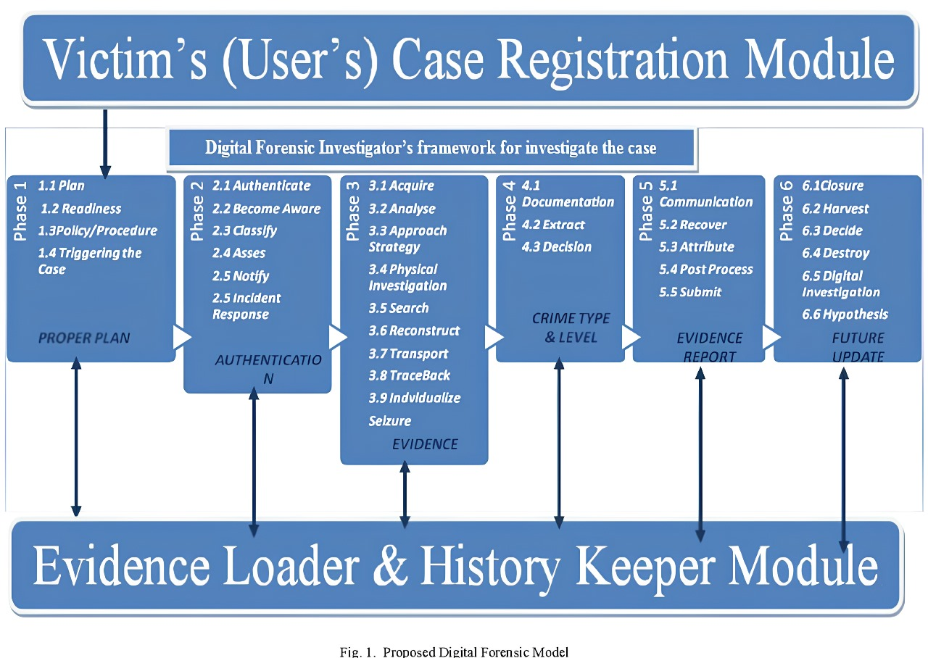
TECHNICAL APPROACH
Team Abyss
AI/ML Development:
Build models for pattern recognition and IOC detection in forensic data. Some models like Splunk, IBM QRadar etc. Will be used as a basis to train our own model.
Encryption & Security:
Apply strong encryption and secure authentication to protect data.
Cloud Services (Initial):
Initially we will host it on AWS/Google Cloud with MongoDB integration for scalable data management.
Blockchain (Future):
We will be implementing a decentralized blockchain based storage for tamper-proof evidence storage.
Product Status: We are currently in the development phase, focusing on AI/ML integration and forensic data processing. For future scalability, we aim to establish a decentralized, blockchain-based database, provided that the cost of implementation can be optimized.

Slide 4
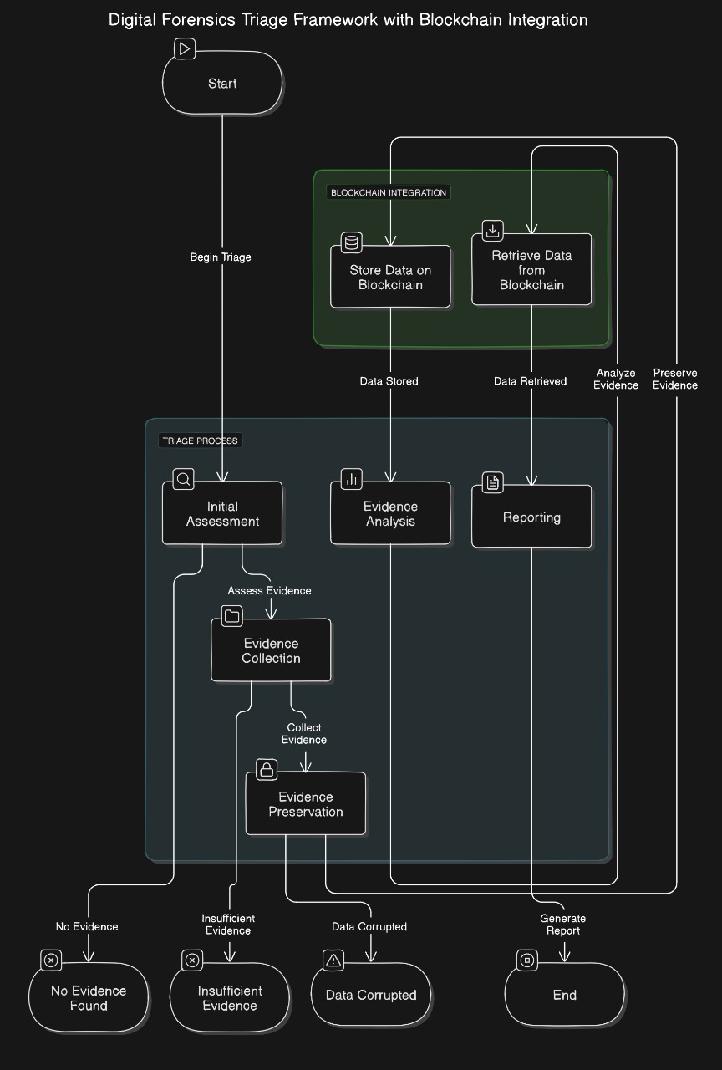
Team Abyss

Slide 5
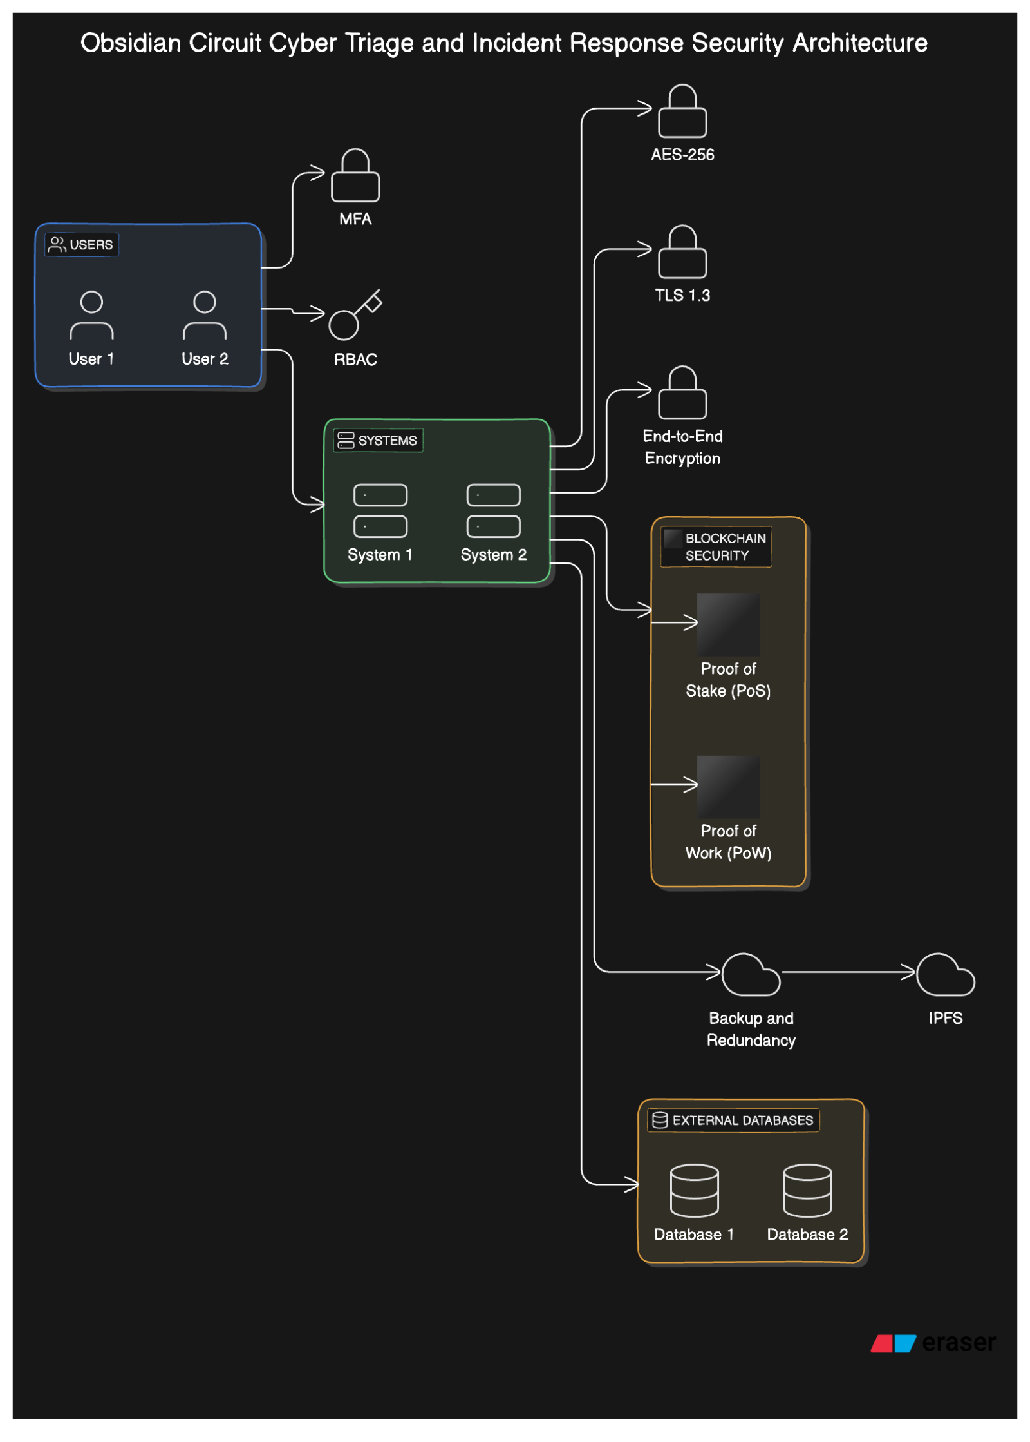
MFA (Multi-Factor Authentication): Secures user access by requiring multiple verification steps.
RBAC (Role-Based Access Control): Ensures only authorized users have access to system components based on their roles.
AES-256 Encryption: Protects data at rest, ensuring forensic data is stored securely.
TLS 1.3 Encryption: Secures data transmission between systems and components.
Blockchain Security: Security through Public key Cryptography , Hash functions, decentralization and Smart Contract Security and Automation.
Backup and Redundancy: Ensures data protection and recovery using IPFS (InterPlanetary File System).
End-to-End Encryption: Provides full encryption throughout the workflow.

Slide 6

FEASIBILITY & VIABILITY
Team Abyss
Analysis of the feasibility of the idea:
Technical Feasibility: Technology Availability: Rust or Python, TensorFlow, MongoDB, etc.
Integration: Use of existing forensic tools like FTK Imager ,AperiSolve or VirusTotal initially and then writing the source code for this,
independently without the help of API’s.
Market Feasibility: Demand Analysis: Increasing need for robust cybersecurity tools in the enterprise sector.
Potential Challenges and Risks:
Technical Challenges:
Ensuring the accuracy of AI/ML models in detecting threats and
anomalies.
Safeguarding data integrity, particularly with sensitive forensic evidence, and maintaining robust encryption.
Integration Complexity:
Seamless integration with existing forensic tools like Aperi Solve
ensuring compatibility with various data formats.
Strategies for Overcoming Challenges:
Technical Solutions:
Regular model updates and security audits to ensure AI/ML accuracy and robust encryption for data protection.
Market Solutions:
Provide focused training for forensic teams to ease the adoption of new tools and offer continuous support and product updates to build trust in the technology.

Slide 7
IMPACT AND BENEFITS
Team Abyss
Potential Impact on the Target Audience:
Forensic Investigators: Faster, more accurate investigations
through automated analysis.
Enterprise Security Teams: Improved threat detection with tamper-proof evidence for compliance.
Law Enforcement: Reliable, secure evidence storage ensuring integrity in legal cases.
IT Administrators: Simplified integration and automation reduce workload while enhancing security.
Benefits of the solution:
Enhanced Accuracy: AI/ML models improve threat detection and reduce false positives.
Efficiency: Automated evidence gathering and
analysis speed up forensic investigations.
Data Security: Blockchain ensures tamper-proof evidence storage and an immutable chain of custody.
Scalability: Cloud integration offers flexible and scalable data management.
Compliance: Comprehensive reporting meets legal and regulatory standards with blockchain verification.

Slide 8
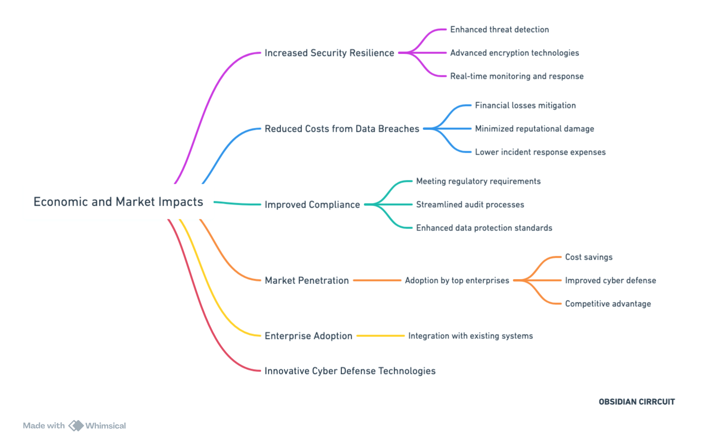

Slide 9
RESEARCH AND REFERENCES
Team Abyss
M. B. Jiménez, D. Fernández, J. E. Rivadeneira, and R. Flores-Moyano, "A Filtering Model for Evidence Gathering in an SDN-Oriented Digital Forensic and Incident Response Context," *IEEE Access*, vol. 12, pp. 75792-75808, 2024, doi: 10.1109/ACCESS.2024.3405588.
O. I. Falowo, K. Koshoedo, and M. Ozer, "An Assessment of Capabilities Required for Effective Cybersecurity Incident Management - A Systematic Literature Review," in *2023 International Conference on Data Security and Privacy Protection (DSPP)*, Xi'an, China, 2023, pp. 1-11, doi: 10.1109/DSPP58763.2023.10404318.
D. Dunsin, M. Ghanem, K. Ouazzane, and V. Vassilev, "A comprehensive analysis of the role of artificial intelligence and machine learning in modern digital forensics and incident response," *Forensic Science International: Digital Investigation,* vol. 47, pp. 2666-2817, 2024, doi: 10.1016/j.fsidi.2023.301675.

